Slide 1

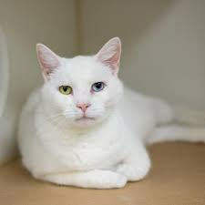
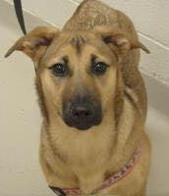
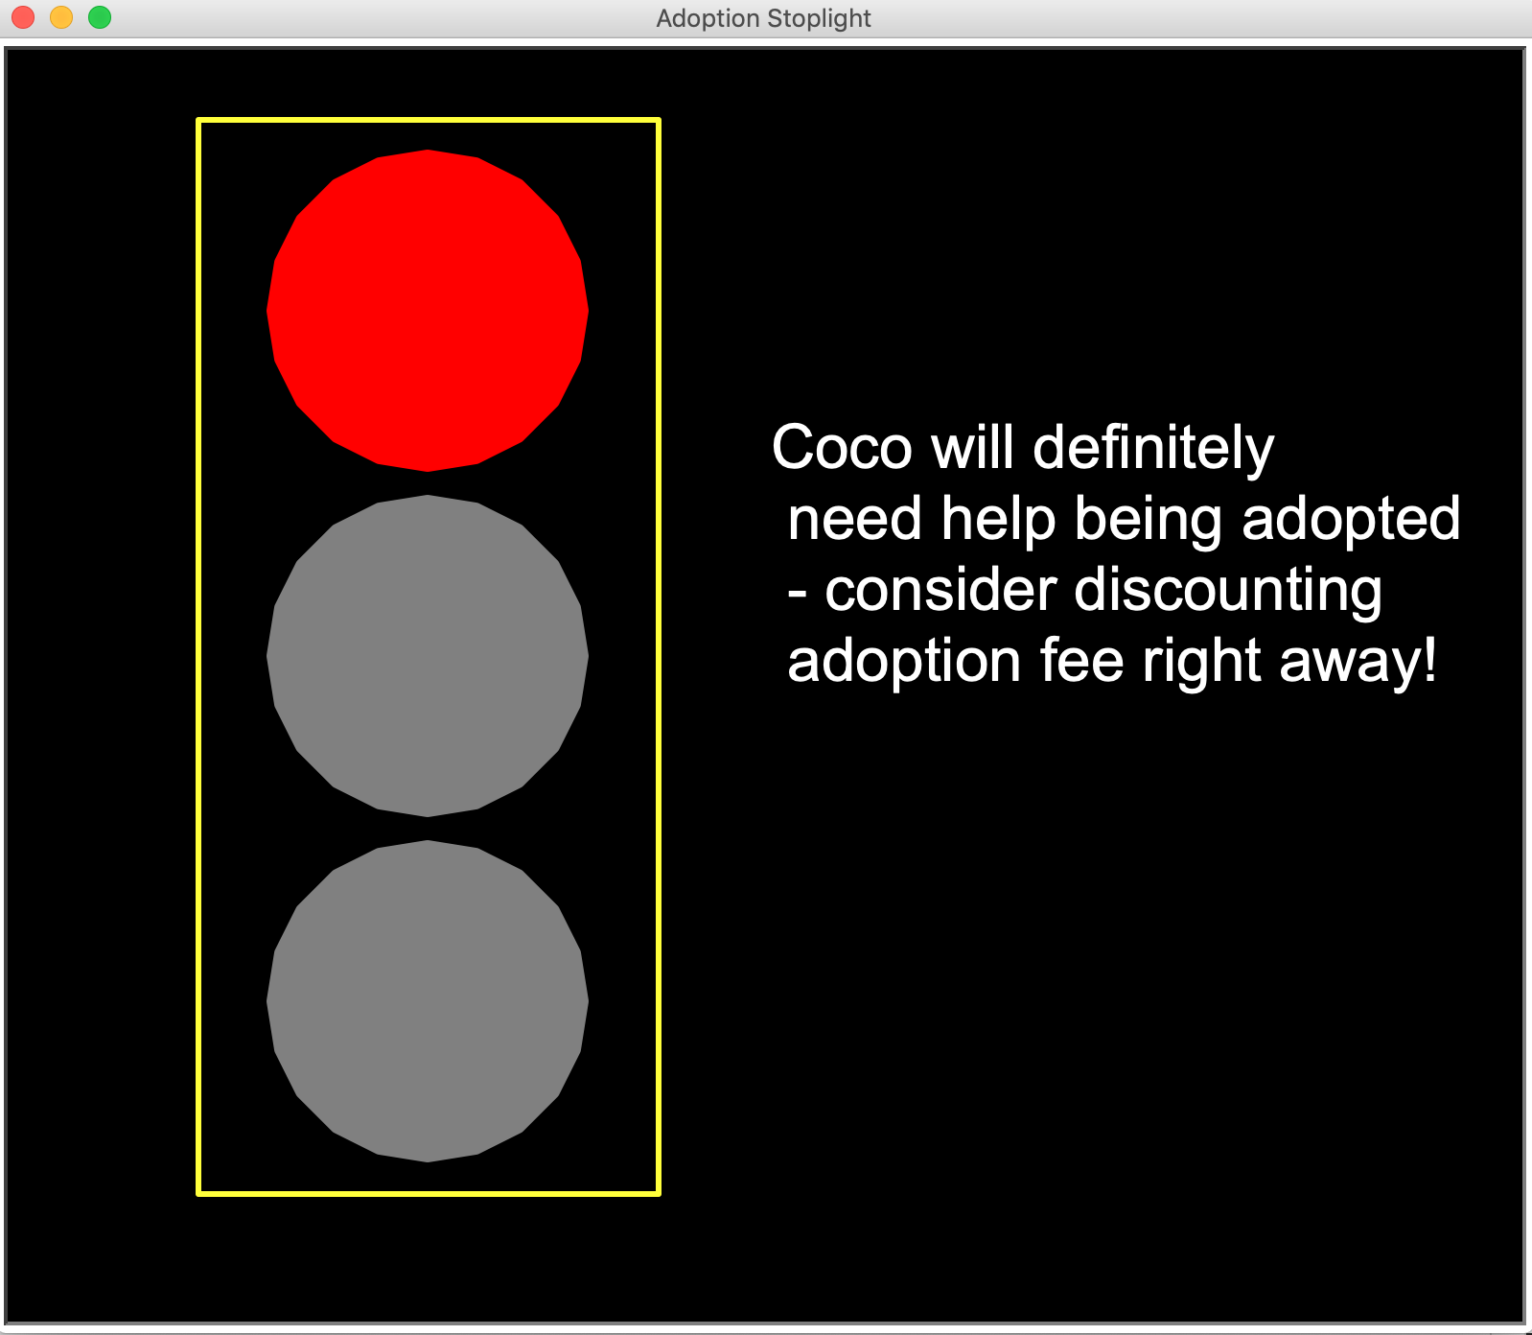
How Adoptable?
Helping shelters know which animals need help being adopted!
By: Tali Higgins
https://github.com/ksu-is/Adoption_Stoplight

